Slide 1




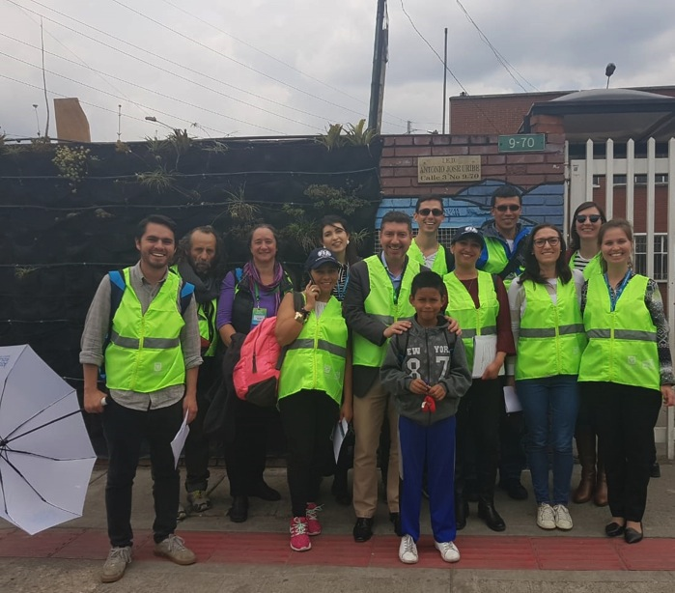
“Paving Safer Path to School”
Report after completion

Slide 2

Why Did we propose this project?
The Road accidents known as the silent killer has begun to take away our future leaders in a nasty manner. Who will believe that globally, a child is dying in every 3-4 minutes due to road accidents?
Thanks to FIA, the world is now hearing about this issue and FIA members are attempting to minimise the occurrences.
In Sri Lanka, the students are the most vulnerable to this evil and it is the right time to act than feel sorry. In Sri Lanka,we are looking forward to benchmark on creating safer roads near schools.

Slide 3
Key notes- Before development
15 schools were screened to evaluate the current status in relation to the safety of the road and the surrounding areas of the school.
Project team met all 15 Principles of selected schools, in order to obtain consent to take photographs of students travelling to school and the surroundings roads of the school.
They were enlightened of the fact that globally, every 3-4 minutes, a child dies on the road due to road accidents.

Slide 4
Key notes
They were also educated on varied projects such as: Prevent children in travelling in footboards of busses and trains; importance of accompanying children with helmets on motorbikes; importance of wearing a helmet when cycling on roads; child restraining in vehicles; the rules to be followed when walking on footpaths and pedestrian crossings on main roads; conducted by AA Ceylon with the grant assistance of FIA under UN's DECADE OF ACTION FOR ROAD SAFETY.
Every Principal offered 100% of their commitment to come on board (if selected after final analysis) and support any project that is conducted to improve the safety standards in the vicinity of their schools.

Slide 5
Key notes
Although 4 schools were shortlisted, only the most vulnerable school was selected for the project due to budgetary constrains and operational convenience.
At this hour, undertaking many school projects may also not be feasible due to the aftermath of Covid 19 pandemic. Hence, Our project team evaluated the schools, audited and unanimously selected one school that is at high risk to be included in our project proposal.
We have discussed with the RDA, Municipal Council (Pradeshiya Sabha), the Police and the National Council for Road Safety (NCRS) to assist us to obtain bridging funds and to ensure that all developments are carried out within legal guidelines. The response was very satisfactory.
We will not request for sponsorship/ donations from private institutes/ partners for this project, since most of them have given donations to support small & medium entrepreneurs effected by the lockdown.

Slide 6
The selected school
WP/ Mattegoda, Vidyadeepa Maha Vidyalaya was selected to conduct the road safety enhancement project. We had lengthy discussions with the Principal and a few teachers regarding the current status of the school's vicinity. Furthermore, we discussed with the officers of the traffic Police in Homagama to learn the current procedures and practices implemented to create safer roads near the above mentioned school.
There had been a few minor accidents due to vehicles approaching the junction carelessly and speeding near the curved road between the junction and the school. One motorcyclist has died on the spot, after colliding on the school's parapet wall due to high speed. Most small accidents are now not reported to Police, since Insurance companies permit motorists to claim minor damage claims without Police reports, but by sending a technical officer to evaluate the damage to the vehicle at site.

Slide 7
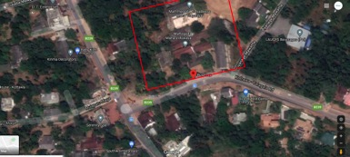
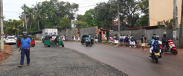
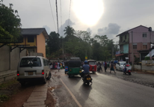
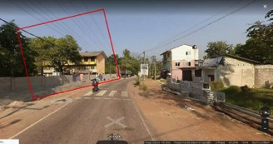
The school selected
 | Roads selected
 | State/Province | District | Road Name | Link ID | Start Point | End Point | Length (km
1 | Western | Colombo | Kottawa -Horana Road | B239 | Start of school wall | End of wall | 60m
2 | Western | Colombo | Kottawa- Mattegoda | B239 | Mattegoda junction bus stand | End of crossing line | 30m

Slide 8
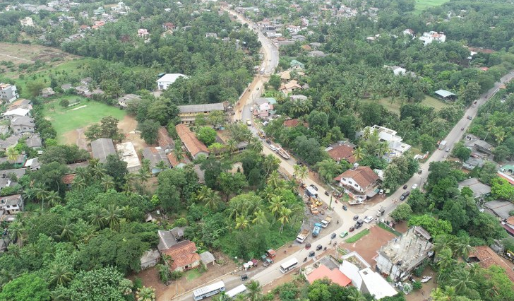

Slide 9
About the selected school
The school is situated next to a main road that connects Kottawa and Horana. This road is also used as a shortcut by many motorists to reach the intersection of the main Colombo - Airport highway. There are many factories situated within 5 - 10 Km of the school and one is situated in the adjoining lane.
There is also an army camp, a University, a sports stadium and a quarry situated in access roads nearby. All of which creates a lot of traffic, which consists of motorcycles, three-wheelers, cars, vans, buses, lorries, and containers.
Over the last five years, the proposed road developments to widen the road did not progress. Hence partly built open canals and drains adjoining the school & on the opposite side of the road too cause dangers to students standing outside the school and after school hours.

Slide 10
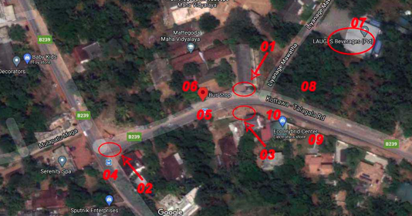
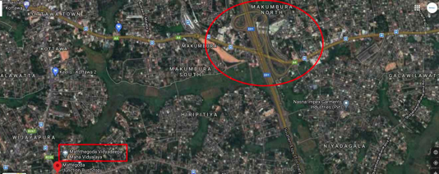
The area selected
Vidyadeepa maha Vidyalaya – School
T intersection (3 legs)
Faded Crossing line in front of the school
Faded crossing line near the 2nd bus stand
Residents & commercial buildings
1st Bus stand
Factory
Motorcycle repair shop
machinery lending shop
Curve

Slide 11
About the selected school
There are commercial properties situated across the school, one of the shops offer construction machineries on rental basis. Many trucks and lorries reverse the vehicles almost in front of the school to load and unload these machines, which create a huge risk to students who travel by bus and walk to school. In addition, there is a shop that repairs motorcycles, which also cause a threat due to them testing the bikes before and after repairs, right next to the school.
The three-way junction situated 150 M from the school, which create a huge traffic and as a result the two old crossing lines (not properly visible) do not give protection to pedestrians, particularly to students. Not all vehicles give way to pedestrians due to this poor vicinity of crossing lines. There are no signage on the side of the road for the vehicles to see at a distance and slow down. No speed limit signage to control the speed.

Slide 12
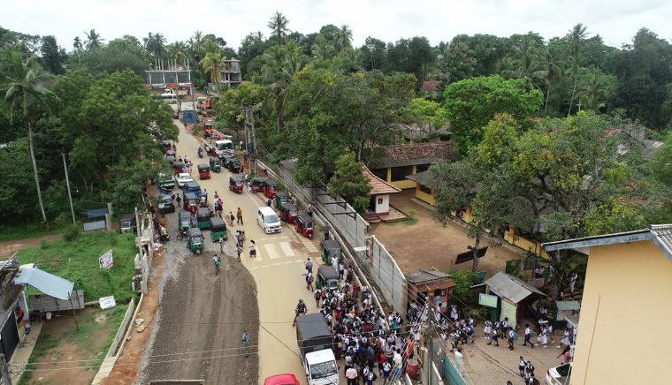

Slide 13
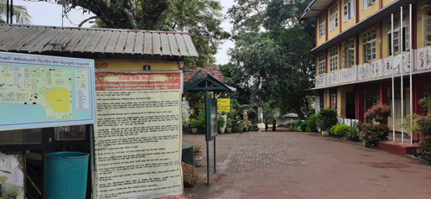
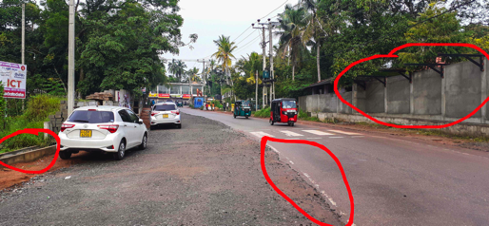
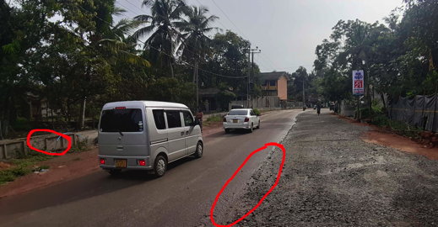
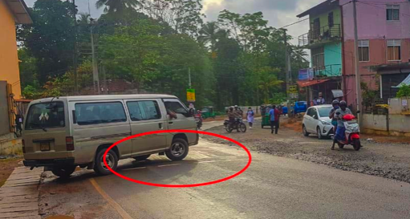

Slide 14
About the selected school
There are no Police officers or traffic wardens to assist students before and after school.
Due to the lack of training, supervision & support of the Police and the poorly maintained signs of the pedestrian crossing have forced the Principal to stop the students from engaging in traffic controlling activities in order to safeguard the children who act as traffic Wardens.
No pavements, railings or footpaths are available in the vicinity of the school.
Buses which get crowded before the said school's bus halt. That impose a huge threat to students when getting into such crowded buses. In addition the motorcyclists attempt to overtake buses from the left even while the bus students get-in/ get-down from buses. No proper bus halt, pavements and road signage.

Slide 15
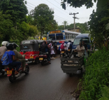
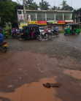
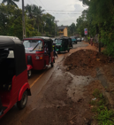
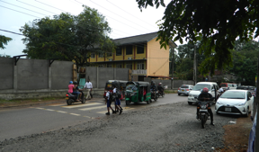
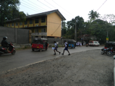
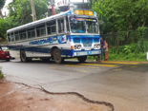

Slide 16
About the selected school
There are no signs to indicate that there is a school ahead or to indicate the speed limits surrounding the school.
Cyclists and motorcyclists do not have specific lanes. Hence, they tend to ignore students who walk on the side and attempt to turn on the unmarked pedestrians' path.
There are no centre lines, side-lines, or Zebra crossings marked on the roads to guide motorists and other road users to be within their stipulated lanes/ paths.
During rainy seasons, rainwater floods the sides of the roads due to lack of proper drains. This forces students to walk on the centre of the main road, to prevent their shoes from getting soaked. This too causes a huge risk to students and teachers who walk to school.

Slide 17
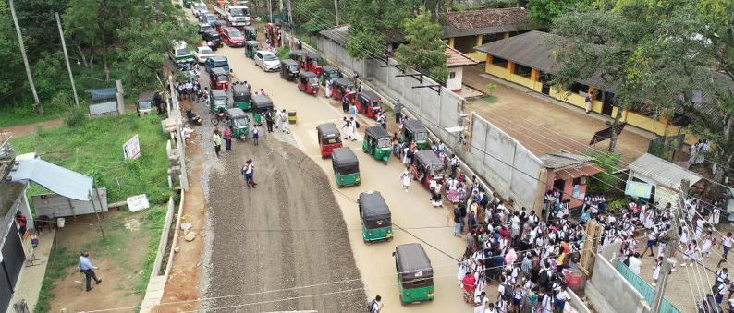

Slide 18
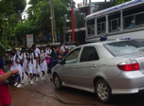

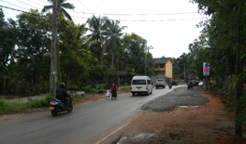
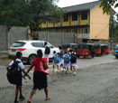
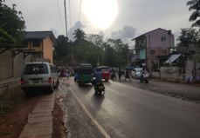
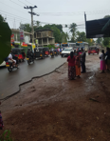
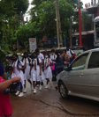

Slide 19
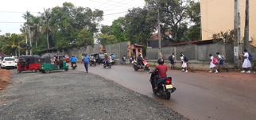


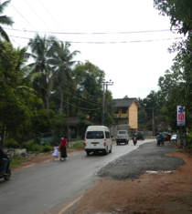

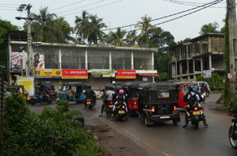
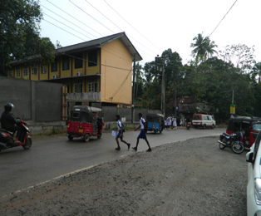

Slide 20
Project Developments cost
We assisted and invested to develop road signs, road markings, crossing lines, safety measurements in front of the school, 1st bus stand, crossing line next to the 2nd bus stand and safer walk paths on both sides of the road (Cost Rs.2,717,440=Euro 12,352)
We also invested on training & engaging students as Traffic wardens /supervisors with proper attire (with FIA, AA Ceylon & iRAP logos) to assist students & teachers near the school - This cost is included in the above quotation received.
RDA, Municipal council & NCRS widen the road & completed it, closed all drains with concrete slabs, marked edge lines at a cost of (Rs. 4,338,560= Euro 19,720)

Slide 21
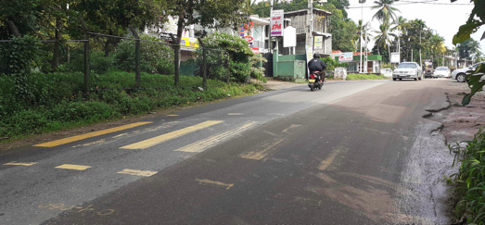
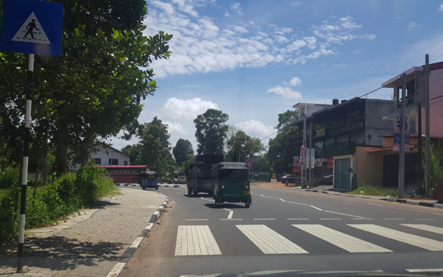
Outcome – Second access road
Now
Before
After development- Crossing was shifted 200m to avoid the junction and to prevent children crossing the road twice to reach the school

Slide 22
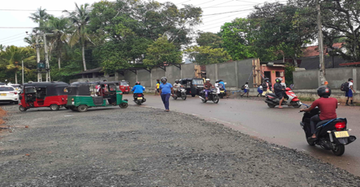
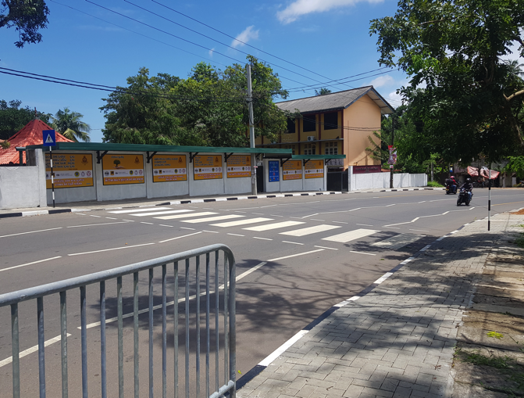
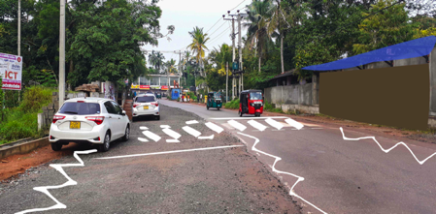
Outcome – Front of the school
Before
Now
Proposed

Slide 23
After the Development- success story
The school selected has been built in 1899 and has a long history of grooming students with commendable academic and sports achievements. It is also situated by the side of a main ‘B’ road that poses a high risk to students and teachers who travel to school.
The Principal, parents of students and the past pupils association appreciated the gesture of AA Ceylon selecting their school under the grants programme of FIA to create a safer environment for students, teachers and all pedestrians. Barely visible marks of the crossings for the pedestrians, the bend of the road just before reaching the school, the unruly traffic of the T junction closer to the school and the few commercial buildings and the factory situated close by imposed a high risk to all pedestrians before the development was done.

Slide 24
After the Development- success story
Proper walking paths and drains with covers (with concrete slabs) were built on both sides of the road to eliminate all possible risks caused to the pedestrians. Now, water does not flow to the road or to the paving area during a rainy season. Metal railings were fixed on the side of the crossing lines and in a few other places to avoid high risks to students.
The students and other pedestrians can now walk safely on the pavements of the road, hence that prevents causing traffic as well as minimise the risk.
Selecting & developing this school was truly justified by the department of education directors and the zonal officials due to the fact that the developments minimised most risks caused to the students and teachers near the school.

Slide 25
After the Development- success story
The local municipal authority and the road development authority supported vehemently, the efforts of AA Ceylon and the FIA to ‘create a safer road’ to students by allocating funds and expediting the road construction to support the project, “safer path to school”.
Meetings held with all authorities including the local municipal council engineer, Director in charge at the RDA , the Minister & Secretary of Ministry of transport, Chairman of National council for road safety and the Deputy General of Police (DIG) in-charge of traffic were very productive. DIG promised to instruct the training division of Police to train the students (traffic wardens) and Master-in-charge on controlling traffice and on ‘How to create a safer path to school’. He will also assign Police officers from the nearest police station before and after school hours to ensure the safety of students.

Slide 26
After the Development- success story
We are happy to keep you posted on the progress made and the attached photographs will enlighten you on the progress made thus far. Construction of the road, bus stands, marking the crossing lines & other lines, drainage work, bus stand and pavements, metal railings, signage to show a school, speed limit (30kmph), crossing line were were completed.
The school authorities will allocate times and dates for the police officers to train students and teachers on traffic controlling and patrolling to assist fellow students and teachers as soon as the reopening of schools (still closed due to Covid 19). The school Principal together with AA Ceylon will organise a ceremony to invite the Minister of Transport, Director Traffic of Police, Chief Engineer of the RDA, Chairman of the municipal council, Chairman of National Council for Road Safety, Directors of the Department of Education to inaugurate the road safety programme.

Slide 27
After the Development- success story
We have fixed display boards with educational messages given by the school principal and Road safety messages based on FIA’s guidelines to create a safer road near a school and together with logos of FIA, FIA grant logo, AA Ceylon, NCRS, Traffic Police.
Once again we profusely thank all the members of FIA who approved this project. We believe this will stand as a benchmark project to other developments taking place to create “A safer path to schools.”

Slide 28
Results [Achieved]
 | Before | Now
Road attribute 1 | Stars 0 -1 | 4-5
Road attribute 2 | Stars 0- 1 | 4-5
Speed limit | 50km/h | 30km/h
Traffic supervisor | no | YES
Road condition | poor | Good
Curve | Moderate | Moderate - Safe
Walk path | No | Available
Crossing & Signage | No | Available
Bus stand | No | Available
Railings | No | Available

Slide 29
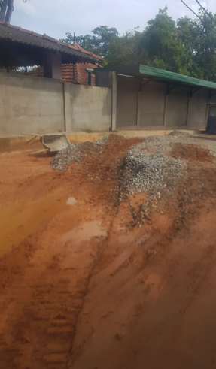
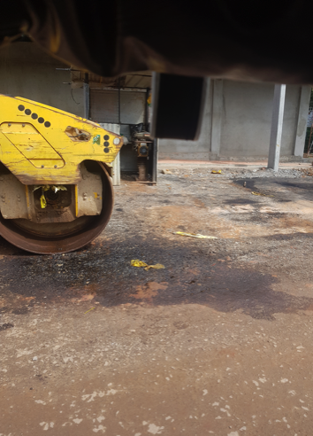
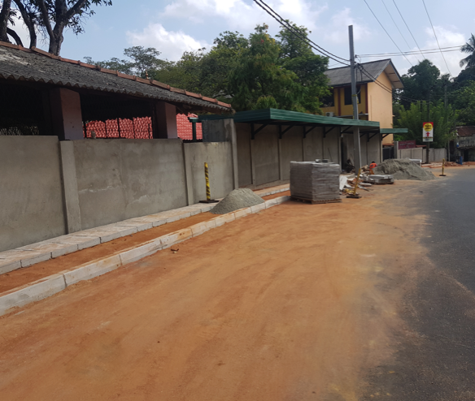
During construction

Slide 30
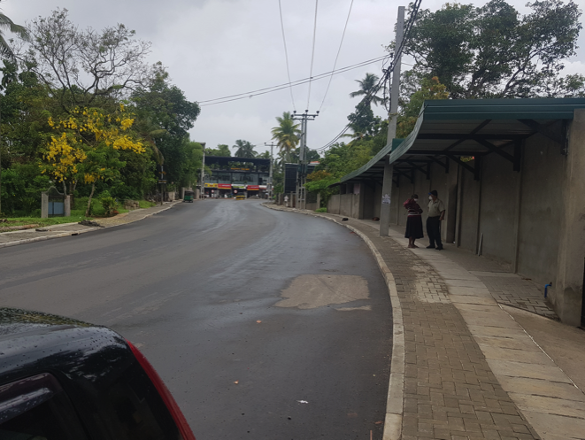
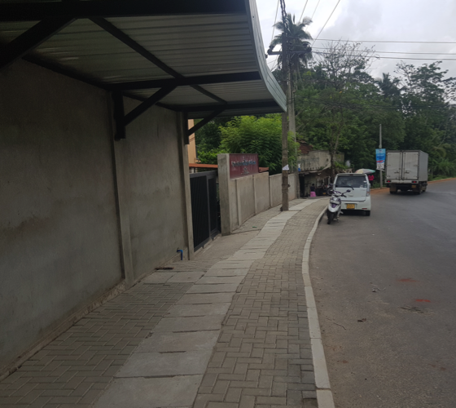
During construction

Slide 31
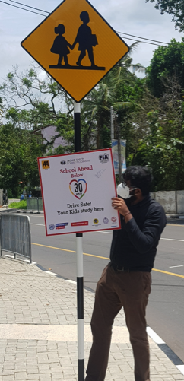
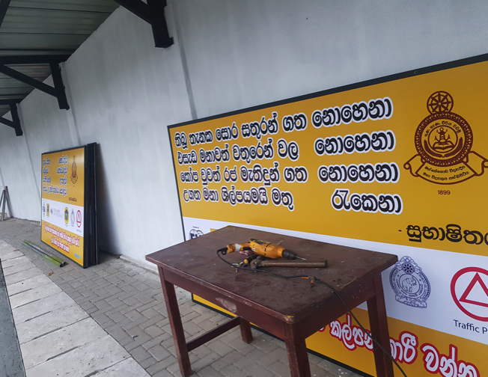
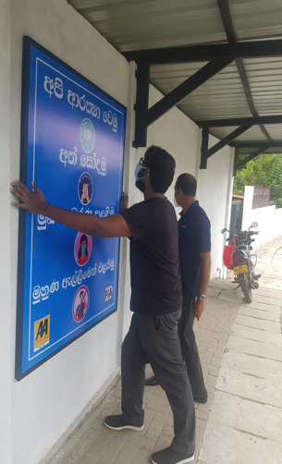
During construction

Slide 32
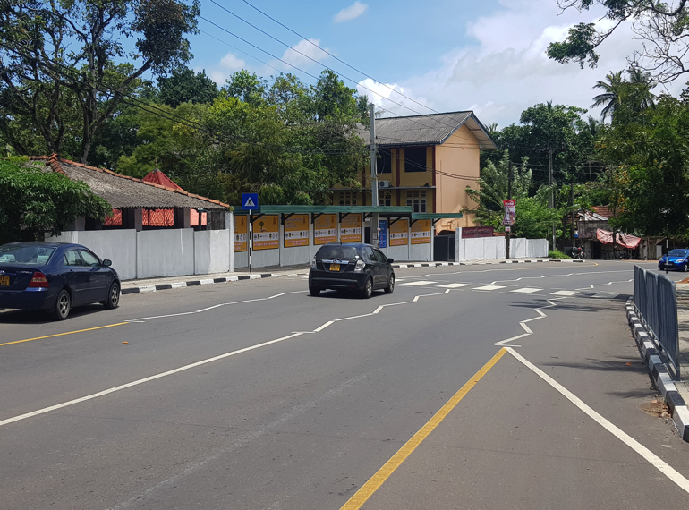
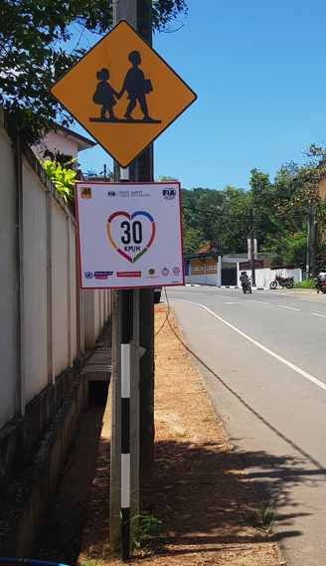
Upon completion – in front of school

Slide 33
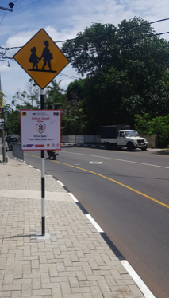
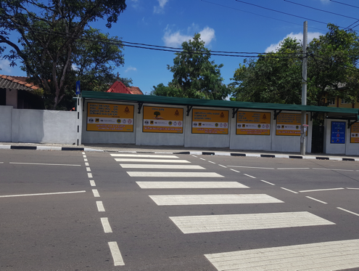
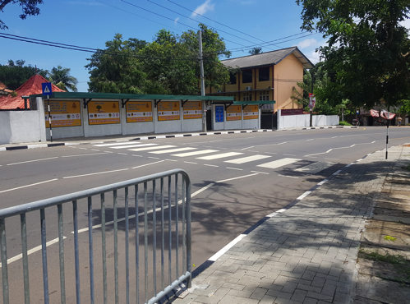

Slide 34
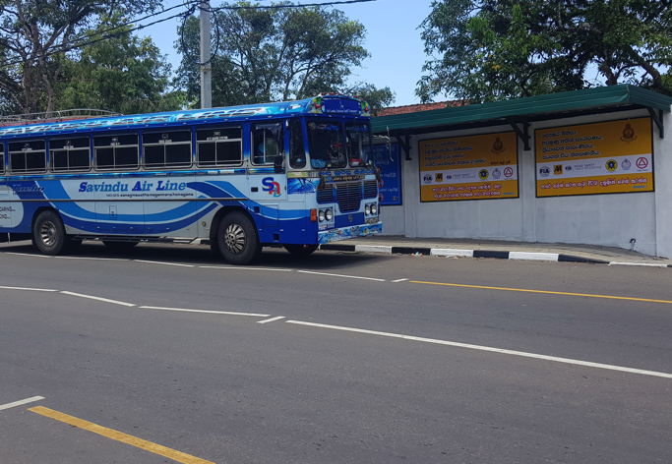
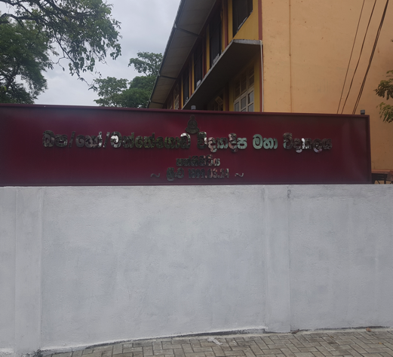
New bus stand, school name board, branding

Slide 35


Crossing line & front view with display boards

Slide 36



Branding, Railings, traffic signs, rain water drainage (covered)

Slide 37
Rating Appendix

Slide 38

Star rating – final outcome

Slide 39


iRAP Rating

Slide 40



Slide 41



Slide 42



Slide 43



Slide 44



