Slide 1
FIA SAFE AND SUSTAINABLE MOBILITY GRANTS PROGRAMME 2024
REPORTING PRESENTATION

Slide 2


‘ Helmet, if you love’

Slide 3
TIMELINE
Safe and Sustainable Mobility 2024
Please provide the timeline overview of your project. PLEASE NOTE THAT THE MONTHS CAN BE CHANGED BASED ON YOUR TIMELINE
July
2024
August
2024
November
2024
September
2024
October
2024
June
2024
Obtain support from Police, National Council for Road Safety & Ministries
Planning all activities
Press conference
Personal visits
Material development
School activations
Dr Seminars
Personal visits
Posters
Stickers
School activations
Street activations
Seminars
Teacher & parents meetings
Posters
Stickers
School activations
Street activations
Police, National Council for Road Safety & Ministries
Evaluating & following on all activities
Police, National Council for Road Safety & Ministries
Evaluating & following on all activities
December
2024
January
2025
February
2025
March
2025
April
2025
May
2025
Influencer
Police, National Council for Road Safety & Ministries
Evaluating & following on all activities
Seminars
Personal visits
Posters
Stickers
School activations
Meetings with Police, Govt Authorities
Meetings with Police, School teachers, parents
Meonitor the progress with Police, School teachers, parents
Observation Research
Observation Research
Visible outcome-80% success

Slide 4
MILESTONES / DELIVERABLES
Safe and Sustainable Mobility 2024
Please provide the milestones / deliverables of your project
Influence the Police to fine parents accompanying children without a helmet in a motorcycle after 3 months grace period (SL Law: Section 158 of the Motor Traffic Act. According to the notification, every person who rides a motorcycle and the pillion on any road should wear a protective helmet with or without a visor.)
Police did not take any action against parents accompanying children without helmets on motorcycles on sympathy grounds. We wanted Police to realise that they are doing more harm than good by allowing children to travel with high risks.
Less than 10% children were wearing helmets before ; aim was to increase the number of children wearing helmets to 90%
Our campaign/ programme forced Police to take action
National Council for Road Safety and Ministry of Transport fully supported the efforts of AA Ceylon in influencing parents to provide
We wanted teachers, parents and all riders to understand the dangers of taking a child in a motorcycle without a helmet

Slide 5
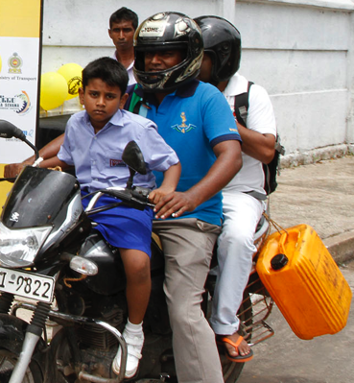
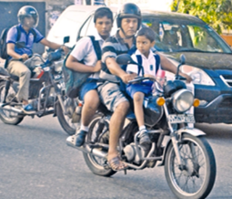
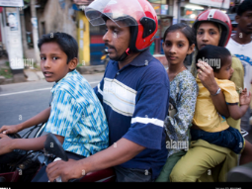
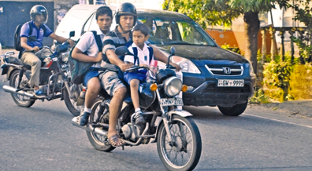
Sri Lankan Roads before the campaign

Slide 6
MAIN ACHIEVEMENTS
Safe and Sustainable Mobility 2024
Please provide the main achievements of your project including numbers so far
We got children involved in convincing Police, parents, teachers and students travelling in motorcycles without a helmet.
We were able to create a huge awareness on the campaign and the reasons why FIA & AA Ceylon conducting campaigns to fight ignorance/ arrogance / stingy attitude of some parents.
Children carried balloons and explain how the head of a child can burst like a balloon, if kids don’t wear helmets when travelling. This was very effective, and some parents & teachers became very sensitive/ emotional after kids explain how much risks they are taking with their kids.
Even though we could not achieve 90% target, observations made by the undergraduates in the University of Moratuwa confirmed that almost 80% of children are wearing helmets.
We had a two-prong approach with Police to influence parents/ guardians to provide a helmet to a child when accompanied in a motorcycle; 1. Warned them and promised to issue a fine next time. 2. Rewarded the parents/ guardians who were accompanying children with helmets by giving Supermarket vouchers, which parents, teachers, Police and all govt. authorities appreciated & vouch to support the campaign & efforts.
Presidential election and General elections held in 2024 disturbed some school & street activities; further change of government & President after election demanded our time to re-visit all authorities to obtain their support. Nevertheless, this was never a challenge and new officials & ministers too vouched to support.
Caption “Helmet, if you love” was a powerful message to all parents.

Slide 7
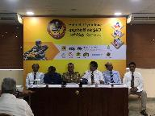




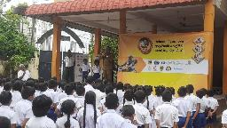
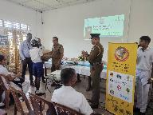
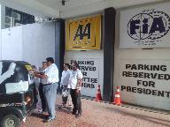
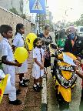
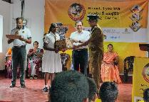
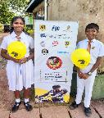
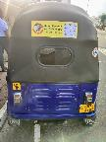
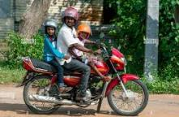
Sri Lankan Roads today after the campaign more than 80% kids wear

Slide 8
FINANCIAL STATUS
Safe and Sustainable Mobility 2024
Please fill in the table below:
ACTIVITIES | BUDGETED- Euro | STATUS TO DATE
Obtain Govt. & Police support | 300 | Completed successfully
Press conference, PR, media & public support | 11,650 | Completed successfully
School & street activations | 8,380 | 80% successful; had many school holidays and limitations with new officials due to Elections/ new government
Seminars with doctors, Police, parents, teachers & principals | 9,850 | Completed successfully, in addition took part in medical exhibition with Sri Lanka’s main children’s hospital
Tuk Tuk Sticker campaign | 1,650 | Completed successfully
Rewarding parents / guardians | 1,500 | Invested more than E 3,000, was V Very effective
Donating / free helmets for kids | 700 | 25 helmets to be given, Donated 450 kids helmets with Police for needy kids/ parents
Social media | 5,000 | Completed successfully

Slide 9
MONITORING
Safe and Sustainable Mobility 2024
Please fill in the table below:
 | INDICATOR | DEFINITION How is it calculated? | BASELINE Value at the beginning of the project? | TARGET What is the target value? | DATA SOURCE How will it be measured? | IMPACT Value at the end of the project / progress report
Impact | Kids to wear helmets when travelling in motorcycles with parents | Mainly observation method/ research | Less than 0% kids were wearing helmets in Sri Lanka | over 90% kids to wear helmets when travelling in motorcycles with parents | Police records, University of Moratuwa research | over 80% wear helmets, Police is monitoring, National council for road safety supports
Outcomes | Kids not wearing helmets are in danger | Easy way is to conduct a study near schools and tuition classes | Ideally , every child should wear a helmet by law, but this can be a 1-3 year project to achieve 100% | now over 80% kids to wear helmets | Traffic Police is on duty near schools & hospitals can monitor | Awareness over 95%, teachers, students, doctors are active on it
Outputs | Education & law enforcement to address | Children, parents, teachers , authorities & Police should understand the repercussions, if kid meet with an accident | Parents ignorance, poor law enforcement, insurance-’on the spot’ claim prevent accident reporting | Police, authorities, parents are willing to take the matter serious | Continuous pressure on Ministry & Police | National council for road safety will impose pressure on parents/ Police to fine
Impact: Impact is the overall goal of the project and should reflect on the ultimate change that the project wants to bring in the lives of the target group. It is the contribution to the overall goal of the project or the organization. Impact may not be achievable within the short duration of project, however, it is always useful to indicate the impact to which the project aims to contribute.
Outcome: Outcomes are results/differences that the project seeks to achieve within the project time frame. It is essential to identify what difference the project will bring about, and who will benefit. These are the clearly measurable results expected from the project.
Output: Outputs are interventions or project activities conducted or planned.
Indicators: Indicators are reliable means that help measure the outputs and outcomes of the project. These can be qualitative or quantitative. Indicators help to verify whether changes or activities expected/ outlined have indeed happened.

Slide 10
IN THE FUTURE…
Safe and Sustainable Mobility 2024
Please tell us more about lessons learned, recommendations. How do you plan to improve Road Safety in your country ? What type of activities will you develop next ?
Saving kids on the roads is a major concern to developing country since unruly drivers, motorcyclists, pedestrians caused serious injuries to many road users and property. Children are vulnerable since many travel to school in motorcycles with parents , school buses & tuk tuks (three wheelers). Even the children come in cars are rarely using safer car child seat.
We conducted many campaigns on child restraining, crossing roads, slow down near schools, not to text while driving, don’t travel on foot-board of school buses which have no doors, creating safer roads near schools with iRap before conducting this campaigns to ensure all children are given a safe kid’s helmet when accompanied in a motorcycle.
The biggest challenge we need to overcome in Sri Lanka is the lenient attitude of the traffic Police when dealing with drivers/ riders accompanying children to school or other places. We have sufficient legislation, but due to the religious background in the country, Police officers are not strict with drivers/ riders travelling with children. We need to change their attitude and make them understand that they are only doing more harm by exposing children to serious injuries, if an unfortunate accident occurs. We have achieve around 70% with our past campaign but need strong public backing to reach 100% or closer.
Testing of vehicle on technical fitness/ road worthiness is not done properly; we are hoping to address this matter in near future. Many fatal accidents have occurred due to public neglecting technical issues/ not repairing on time.

Slide 11

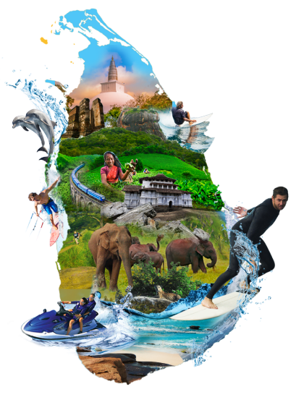
‘ Helmet, if you love’
Campaign is saving future leaders!
Thank you
Your partner in motoring

